Slide 1

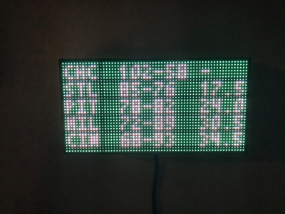
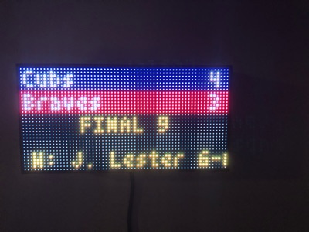
MLB LED Scoreboard
Code Developer: Jacob Hibbert
Original creator: AJ Bowler
“Get live scores, stats, and standings to follow your team to a championship!”

